Slide 1
Data Processing and Dissemination using the Community Satellite Processing Package (CSPP)
Suomi NPP Applications Workshop
18 November 2014
Kathleen Strabala, Liam Gumley, Allen Huang, Scott Mindock, Graeme Martin, Ray Garcia,
Geoff Cureton, James Davies, Andrew Heidinger, Nick Bearson, David Hoese, Elisabeth Weisz, Nadia Smith, Bill Smith Sr.
UW-Madison, Space Science and Engineering Center (SSEC),
Cooperative Institute For Meteorological Satellite Studies (CIMSS)

Slide 2
History of Direct
Broadcast Support
More than 25 years of experience
ITPP (International TOVS Processing Package) since 1985
IAPP (International ATOVS Processing Package) since 1998
Acquisition of TeraScan X Band 4.4 m Dish in 2000
NASA IMAPP (International MODIS/AIRS Processing Package) since 2000
Acquisition of Orbital Systems X/L Band 2.4 m Dish in September 2011
NOAA CSPP (Community Satellite Processing Package) 2011
The goal is to allow DB users the capability to create their own local products for local applications

Slide 3
What is CSPP?
CSPP (Community Satellite Processing Package) is a collection of software systems for processing data from polar orbiting meteorological satellites.
Features
  Ready to install and run on 64-bit Intel Linux (CentOS 6); no compilation required (source code is usually included). Install time < 10 min.
  Supports input data from direct broadcast (primary use case) and from global archives (secondary use case).
  Dynamic ancillary data are downloaded automatically.
  Self-describing output files (e.g., HDF, netCDF).
  Distribution package includes documentation and test data.

Slide 4
CSPP Software Philosophy
CSPP software must:
Create useful products for the DB community,
Include up-to-date algorithms,
Be pre-compiled for 64-bit Linux,
Be easy to install and operate,
Include test data for verification,
Include quick look image capability,
Have prompt user support,
Run efficiently on modest hardware.

Slide 5
CSPP LEO Satellites and Sensors
CSPP includes support for Suomi NPP and JPSS, POES, MetOP, Terra, Aqua, and eventually FY-3.
For Suomi NPP, supported sensors include VIIRS, CrIS, ATMS (SDRs and a subset of EDRs).
For POES and Metop, supported sensors include AVHRR, IASI, AMSU-A/B, MHS (Level 2 products only; Level 1 processing provided by AAPP).
For Aqua and Terra, supported sensors include MODIS, AIRS, and AMSU.

Slide 6
CSPP Data Distribution
  All UW DB CSPP products distributed via public ftp site in real time:
    ftp://ftp.ssec.wisc.edu/pub/eosdb/npp/
  Products for the National Weather Service distributed via the Local Data Manager (LDM)
    CSPP VIIRS Polar2grid reprojects and reformats VIIRS data and products for display in AWIPS-I and AWIPS-II
      Currently delivering files in Pacific Region (HCC antenna), Alaska Region (GINA antenna) and CONUS (UW+Oregon State antennae).
  Web Map Service: http://re.ssec.wisc.edu/
    DB SDR plus Global VIIRS Atmosphere SIPS SDRs

Slide 7
Current CSPP LEO
Software http://cimss.ssec.wisc.edu/cspp/
Suomi NPP CrIS, VIIRS and ATMS SDR (geolocation and calibration)
Suomi NPP VIIRS EDR (cloud mask, active fires, surface reflectance, NDVI, EVI, Surface Type, SST, Aerosol Optical Thickness, Suspended Matter, Land Surface Temperature)
CrIS, IASI, and AIRS Dual Regression Retrieval
VIIRS SDR GeoTIFF and AWIPS Reprojected Imagery
Microwave Integrated Retrieval System (MIRS)
Clouds from AVHRR Extended (CLAVR-x)
HYDRA2 Multispectral Data Analysis Toolkit
VIIRS Imagery EDR (projected imagery for AWIPS)

Slide 8
CSPP Users
> 700 global registrants
EUMETSAT for EARS-NPP EUMETCast distribution UK Met Office Météo-France CSIR South Africa Swedish Met Service DWD – German Met Service Australia Bureau of Meteorology Taiwan Central Weather Bureau Belarus National Academy of Science Indonesia Government Space Agency (LAPAN) German Aerospace Center CONABIO Mexico EURAC Remote Sensing Institute Italy | China National Satellite Meteorological Center Brazil INPE Danish Meteorological Institute Japanese Meteorological Agency Norwegian Meteorological Institute Swedish Met Institute Kazakhstan Space Investigation Institute UK Plymouth Marine Lab Naval Research Lab Vendors SeaSpace, ScanEx, SpaceTec and others. In addition, CSPP DB products are being used in the US NWS in HI, Alaska and CONUS

Slide 9
VIIRS, CrIS, and
ATMS SDR
Converts RDR files (CCSDS packets) to SDR files (geolocation and calibrated radiances and reflectances)
Based on operational algorithms and lookup tables (IDPS version Mx8.4)
CSPP version added features include multi-core processing, automated LUT updates, granule aggregation, HDF5 compression.
Supports CrIS full spectral resolution data.
Distribution Example: ftp://ftp.ssec.wisc.edu/pub/eosdb/npp/viirs/2014_11_17_321_1658/sdr/

Slide 10
Product Validation
UW performs rigorous validation on products, but also works with external users.
EUMETSAT Chose to use CSPP SDR software for the EUMETSAT Advanced Retransmission Service (EARS)
for S-NPP.
They peformed exhaustive validation to confirm the CSPP SDRs matched IDPS.
Just completed EARS-VIIRS Service - Product Validation Report consists of 481 pages.
Results found: “The data of local and global products match nearly perfectly.”

Slide 11
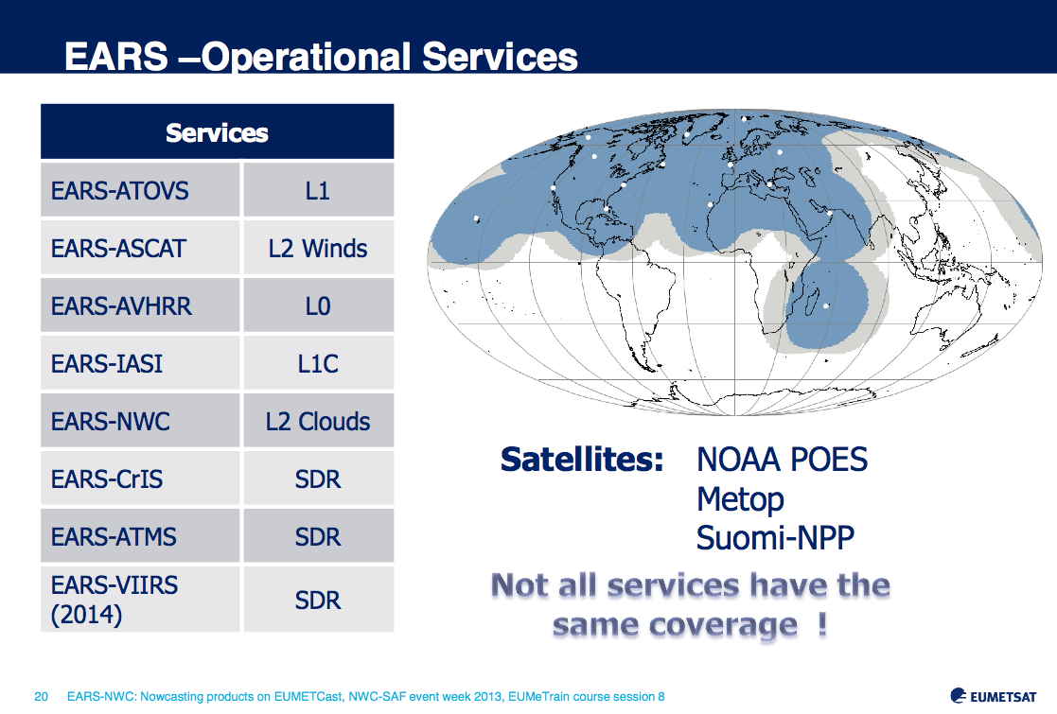
CSPP Supports EUMETSAT

Slide 12
VIIRS EDR
Creates geophysical products from VIIRS radiances and reflectances.
Based on operational algorithms and lookup tables (IDPS version Mx8.4).
Products include cloud mask, active fires, surface reflectance, NDVI, EVI, SST, AOT and LST.
CSPP version added features include selectable products, multi-core processing, automated ancillary data selection download, granule aggregation, HDF5 internal compression.
Distribution example: ftp://ftp.ssec.wisc.edu/pub/eosdb/npp/viirs/2014_11_17_321_1658/edr/

Slide 13
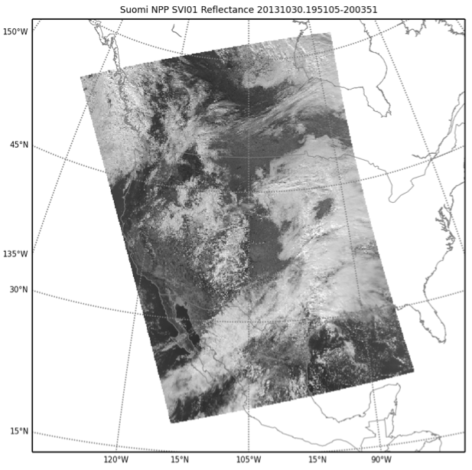
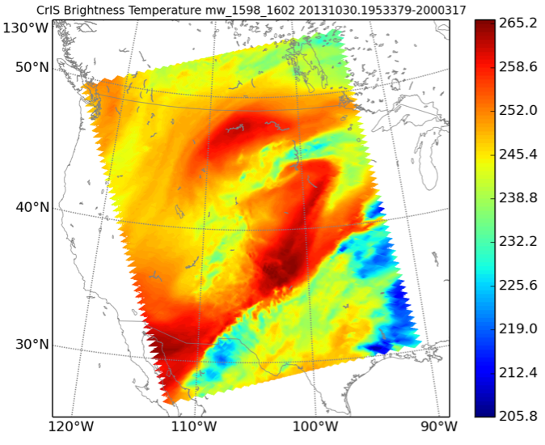
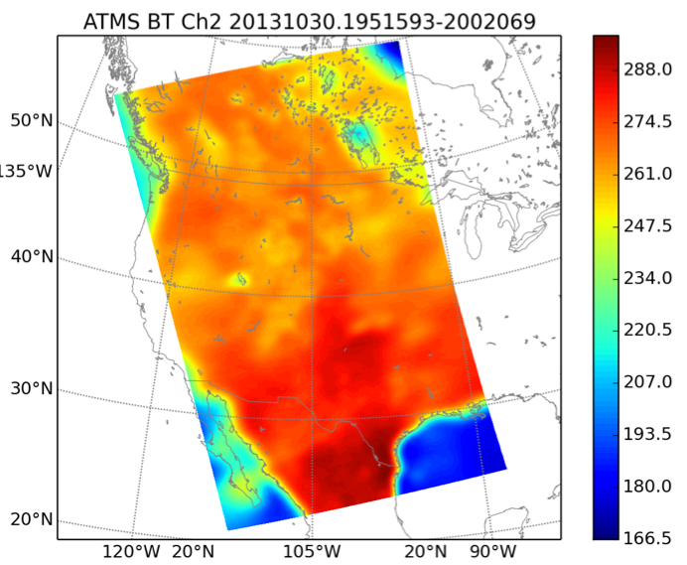
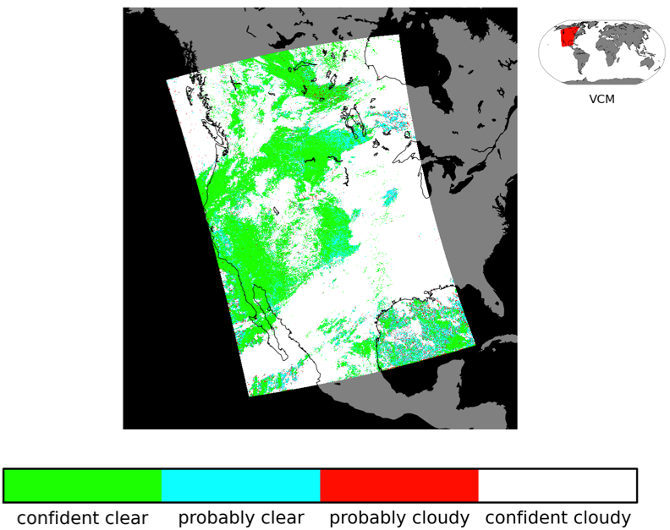
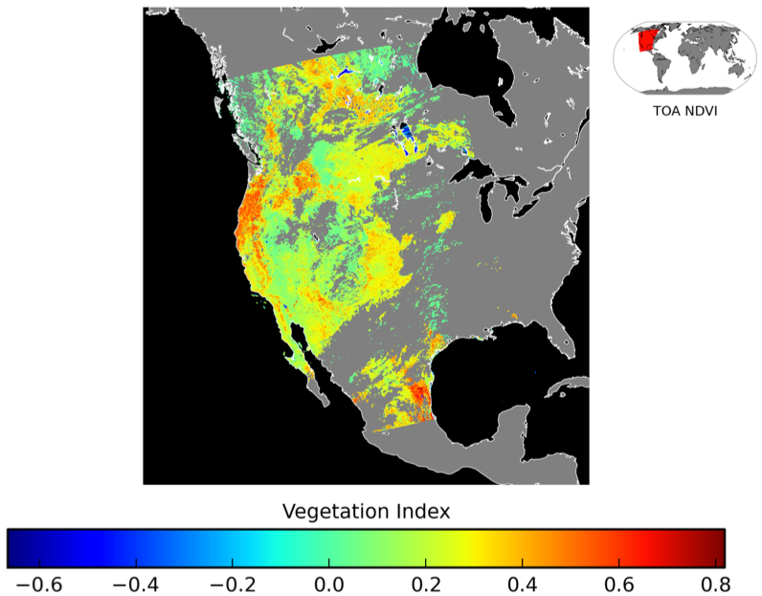
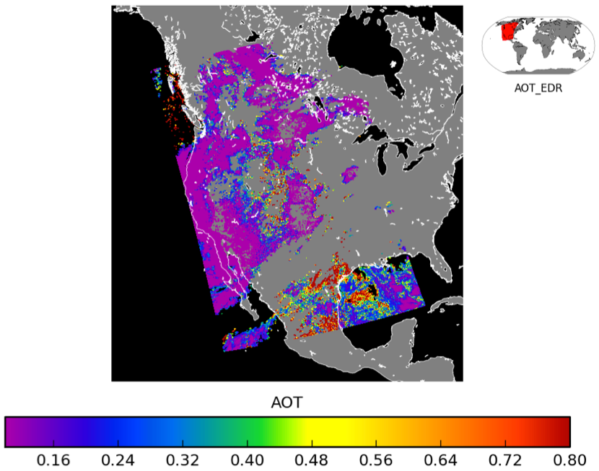
VIIRS EDR Products from SSEC DB
VIIRS SDR
CrIS SDR
ATMS SDR
VIIRS Cloud Mask
VIIRS NDVI
VIIRS AOT

Slide 14
Hyperspectral Sounder
Dual Regression Retrievals
Computes profiles of atmospheric temperature, moisture, and ozone from CrIS SDR; IASI and AIRS Level 1B.
Computes cloud top products (height, pressure, emissivity) surface parameters.
Common fast regression algorithm by Bill Smith, Elisabeth Weisz, Nadia Smith.
Products are created for every FOV, clear and cloudy.
Distribution example: ftp://ftp.ssec.wisc.edu/pub/eosdb/npp/cris/2014_11_17_321_2018/edr/

Slide 15
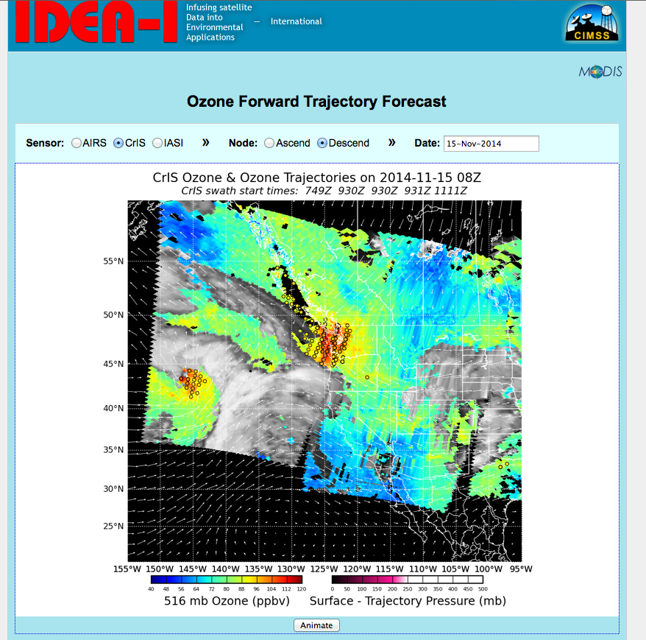
Hyperspectral Sounder
IDEA-I Ozone Trajectories
http://cimss.ssec.wisc.edu/idea-i/USozone/
Used to forecast
Stratospheric Ozone intrusions for help with
identifying “exceptional events”.
Brad Pierce demonstrated
the IDEA-I ozone trajectory forecasts capabilities using an event in June 2012 (AIRS).

Slide 16
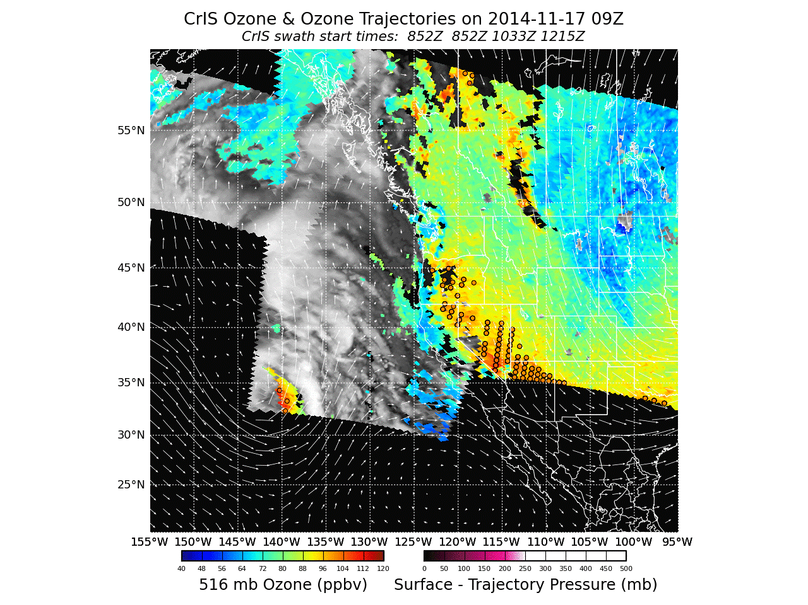


Slide 17
VIIRS SDR Projected
Imagery (Polar2Grid)
Creates VIIRS imagery on a user-defined grid and projection (can use proj4 grid definitions).
Runs corrected reflectance as part of true color image generation; one command execution.
Reads multi-granule VIIRS SDRs as input (M-band, I-band, and DNB).
Saves images in GeoTIFF and AWIPS formats.
Used operationally at SSEC, GINA and Honolulu to create products for National Weather Service Forecast Offices.
Example distribution (full res all band VIIRS GeoTIFFs available for each pass): ftp://ftp.ssec.wisc.edu/pub/eosdb/npp/viirs/2014_11_17_321_1658/geotiff/

Slide 18
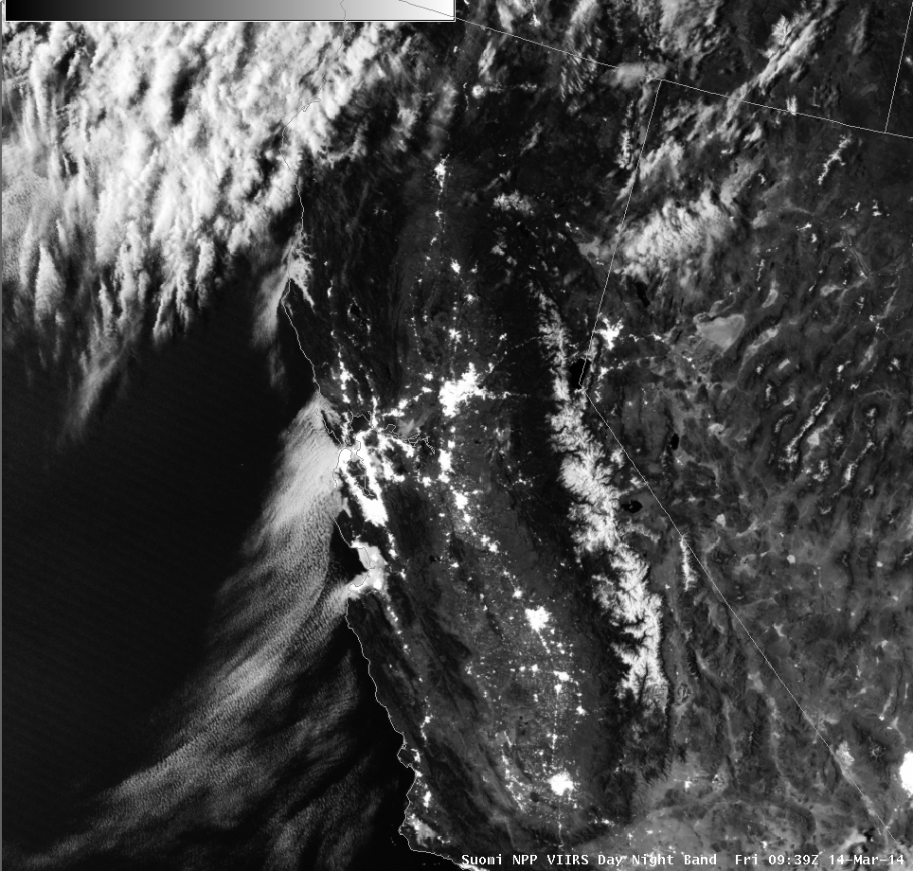
Low Cloud/ Fog Seen by VIIRS DNB at Night
AREA FORECAST DISCUSSION
NATIONAL WEATHER SERVICE SAN FRANCISCO BAY AREA
443 AM PDT FRI MAR 14 2014
.DISCUSSION...AS OF 4:10 AM PDT FRIDAY...THE DRY TAIL END OF A WEATHER SYSTEM MOVING IN TO THE PACIFIC NORTHWEST IS APPROACHING OUR DISTRICT...AND RESULTING IN ENHANCEMENT OF THE MARINE LAYER AND A RETURN OF THE MARINE STRATUS. LATEST GOES FOG PRODUCT IMAGERY...AND IN RATHER SPECTACULAR DETAIL JUST REC'D SUOMI VIIRS NIGHTTIME HIGH RES VISUAL IMAGE...SHOW COVERAGE ALONG MUCH OF THE COAST FROM PT REYES SOUTH TO THE VICINITY OF THE MONTEREY PENINSULA...AND A BROAD SWATH EXTENDING INLAND ACROSS SAN FRANCISCO AND THROUGH THE GOLDEN GATE TO THE EAST BAY. LATEST BODEGA BAY AND FT ORD PROFILER DATA INDICATE A MARINE LAYER DEPTH OF ABOUT 1300 FT. SOME THIN HIGH CLOUDS ARE ALSO PASSING THROUGH ABOVE.

Slide 19
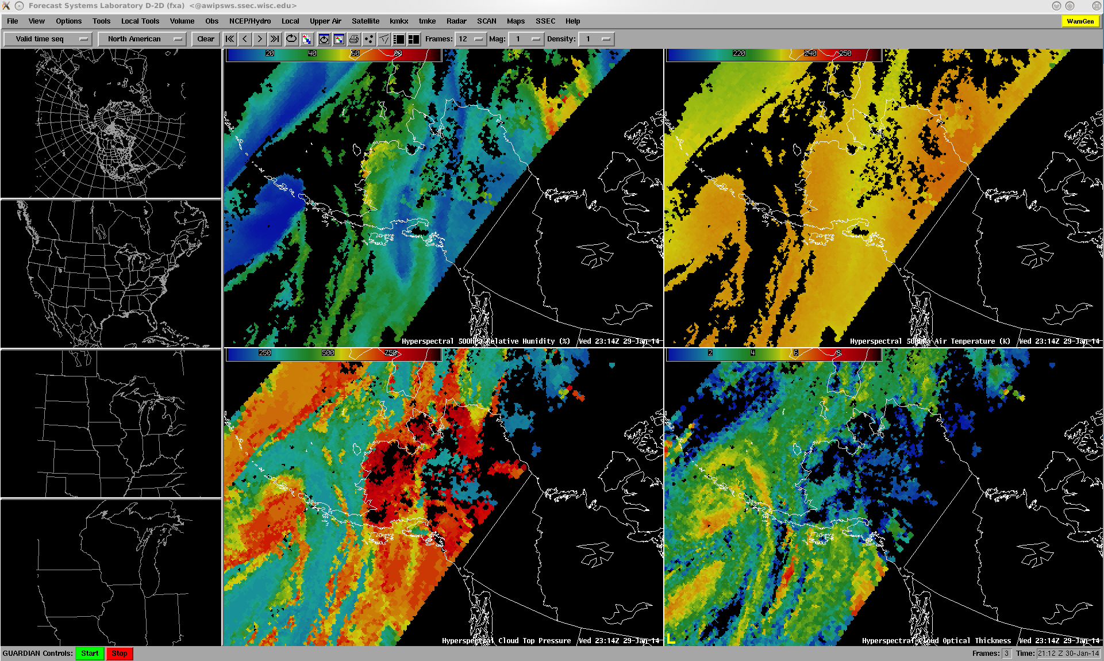
P2G and HSRTV
Polar2grid (a beta-version with sounder processing capability) was implemented at GINA/UAF (April 2014) to convert selected DR retrieval products (i.e., 500 hPa temperature and relative humidity, cloud top pressure, cloud optical thickness, and lifted index) to gridded NetCDF-3 files for display in AWIPS.
AWIPS screenshot showing CrIS 500 hPa relative humidity (upper left panel), 500 hPa temperature (upper right panel), cloud top pressure (lower left panel) and cloud optical thickness (lower right panel).

Slide 20
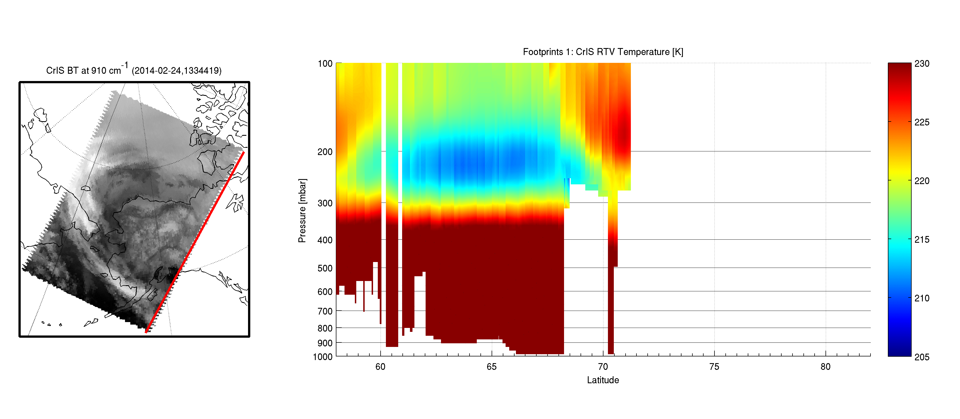
P2G and HSRTV
A new real-time application has been identified: ‘Detection of Cold Air Aloft over the Arctic’, an important NWS aviation safety product. We've since demonstrated the quality of hyperspectral soundings specifically for such an application. Eric Stevens at GINA/UAF is currently working with Kristine Nelson at CWSU, Anchorage in exploring options (e.g. internet-ready graphics) on how to best display the 3-D temperature fields in an operational forecasting system
Demonstration that Dual-Regression retrievals are able to detect cold-air aloft
-43°C
-48°C
-53°C
-58°C
-63°C
-68°C

Slide 21
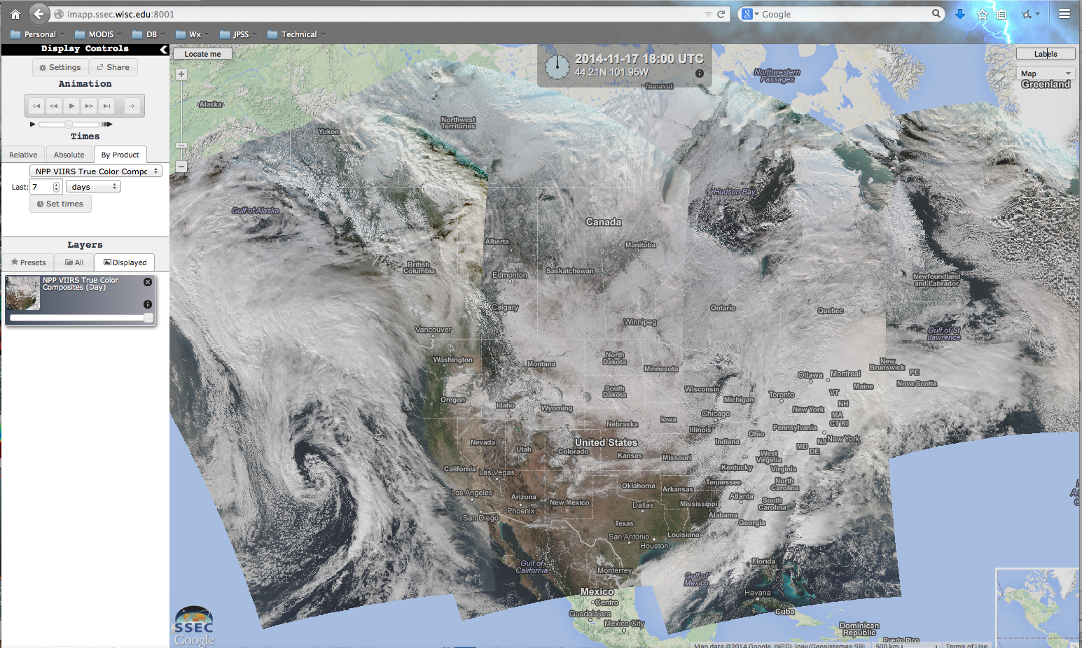
S-NPP Realtime Data in
Web Map Service

Slide 22
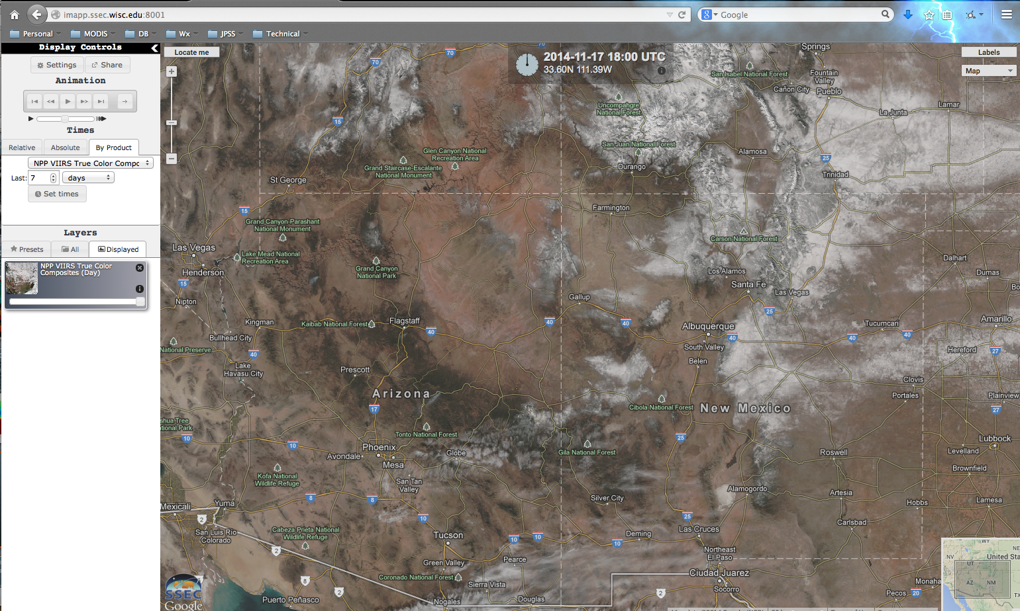
S-NPP Realtime Data in
Web Map Service

Slide 23
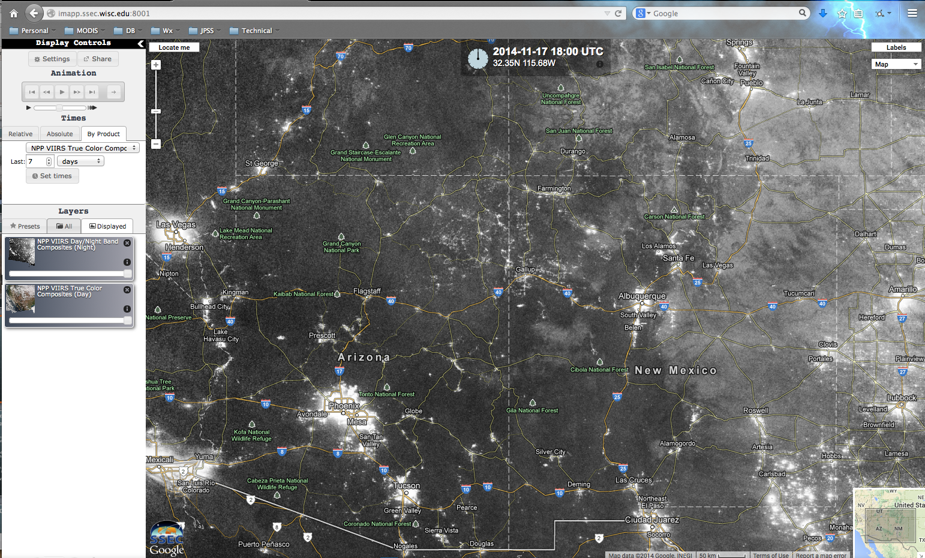
S-NPP Realtime Data in
Web Map Service

Slide 24
Microwave Integrated
Retrieval System
Retrieves atmospheric profile and surface parameters from ATMS, AMSU-A, and MHS sensor SDR and Level 1B data.
Development is led by Sid Boukabara at the NOAA NESDIS Center for Satellite Applications and Research (STAR).
Supports ATMS SDR from CSPP or CLASS, and MetOP/NOAA AMSU-A and MHS from AAPP v7.
Working with Honolulu NWS to provide MIRS products to forecasters.
Example distribution: ftp://ftp.ssec.wisc.edu/pub/eosdb/npp/atms/2014_11_17_321_2018/edr/

Slide 25
MIRS Product List
Official Validated Products:
  Temperature profile over open water ocean
  Humidity profile over open water ocean
  Humidity Profile over non-coastal Land
  Total Precipitable Water (TPW) over open water ocean
  Total Precipitable Water over non-coastal land
  Land surface temperature
  Surface Emissivity over land and snow
  Surface Type Classification
  Snow Water Equivalent (SWE)
  Sea Ice Concentration (SIC)
  Snow Cover Extent (SCE)
  Vertically-Integrated Non-precipitating Cloud Liquid Water (CLW) over open water ocean
  Vertically-Integrated Graupel Water Path (IWP)
  Vertically-Integrated Rain Water Path (RWP)
  Rainfall Rate (RR) over open water ocean and non-coastal, non-snow-covered land surface types
Experimental Products (not fully validated):
  Cloud Liquid Water Profile (CLWP) over ocean
  Surface Temperature (skin) extended to snow-covered land surface type
  Surface Temperature (skin) extended to open ocean water
  Effective grain size of snow (over snow-covered land surface)
  Multi-Year (MY) Type Sea Ice Concentration
  First-Year (FY) Type Sea Ice Concentration

Slide 26
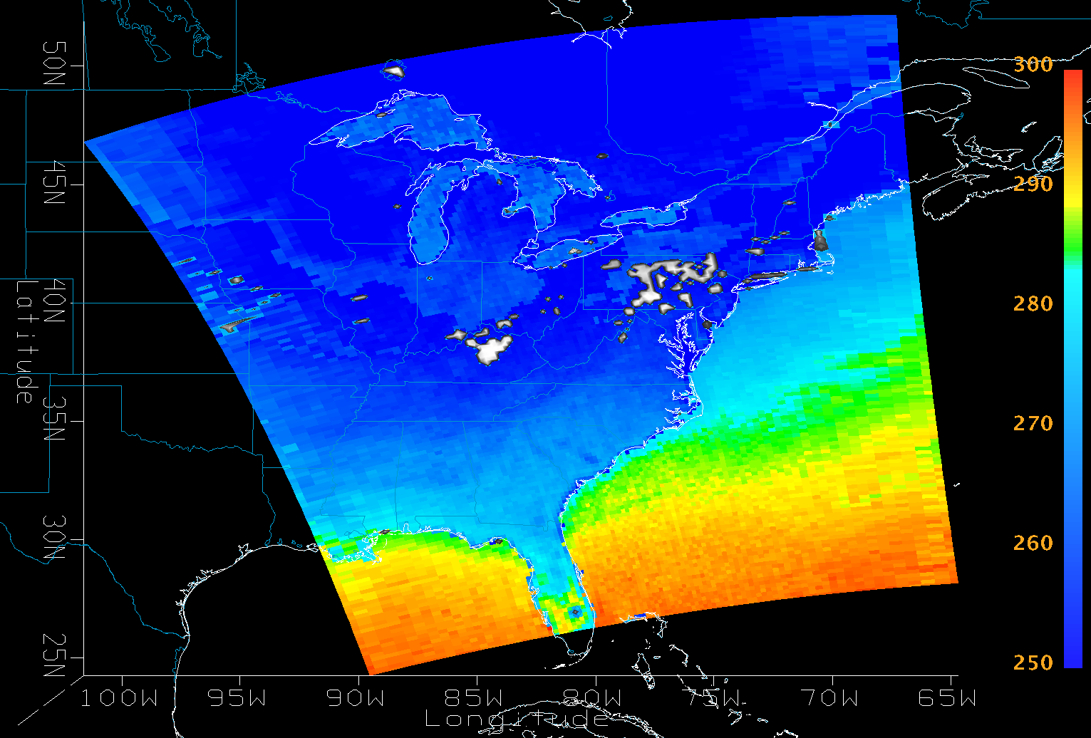
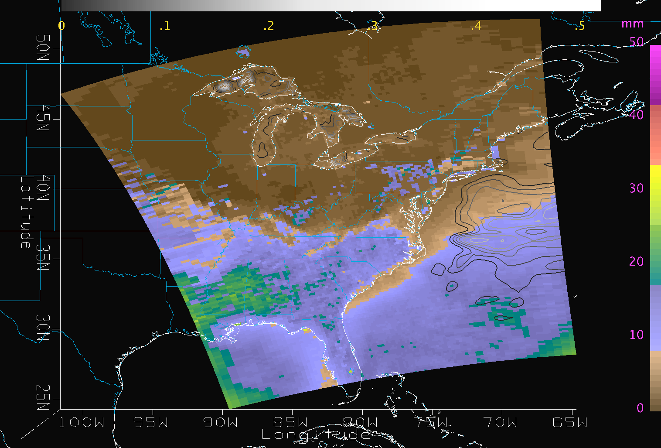
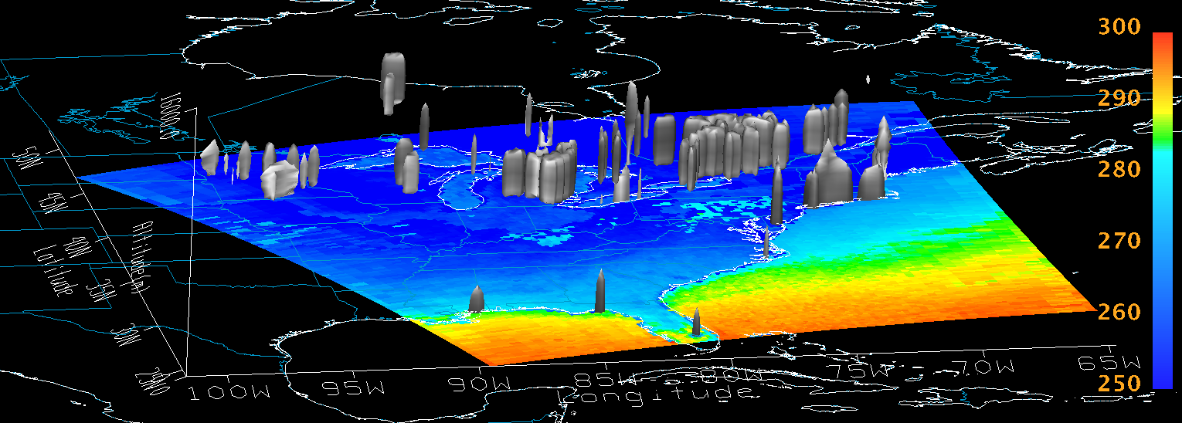
MIRS Products from ATMS DB
Surface Temperature
with Rain Mass Profile
Total Precipitable Water
with contours of Cloud Liquid Water
S-NPP/ATMS
2014-01-23 18:19Z

Slide 27
Clouds from AVHRR
- Extended
CLAVR-x derives cloud parameters (cloud top height, pressure, phase, …) and surface parameters from multispectral imager data.
Development led by Andy Heidinger.
Supports VIIRS, MODIS, and AVHRR.
  VIIRS SDRs from CSPP or IDPS/CLASS,
  MODIS Level 1B from SeaDAS or MODAPS,
  AVHRR Level 1B from AAPP v7.
One algorithm supports multiple sensors.
Andy Heidinger working to integrate CLAVRx into Taiwan Central Weather Bureau DB product suite.
Example realtime file: ftp://ftp.ssec.wisc.edu/pub/eosdb/npp/viirs/2014_11_17_321_2017/edr/CLAVRx.npp_d20141117_t2020415_e2022057_b15841.level2.hdf

Slide 28
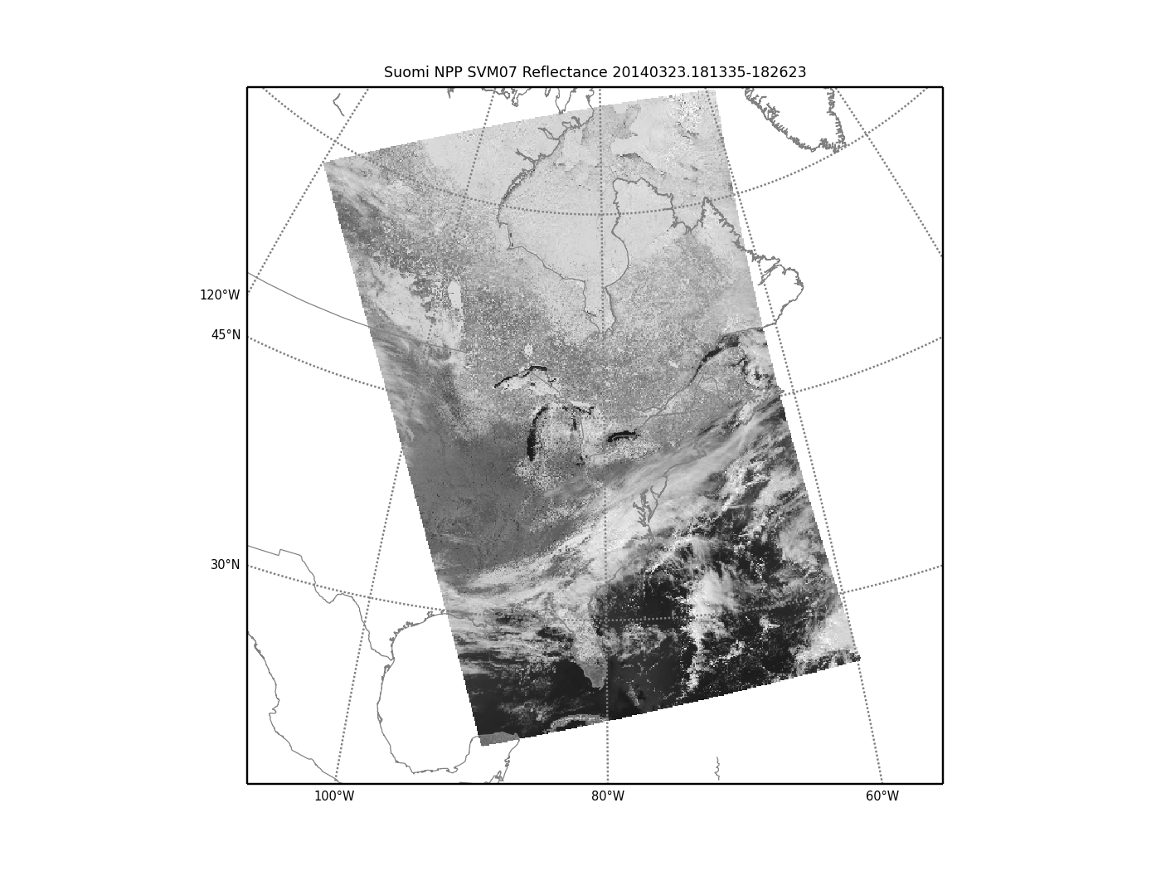
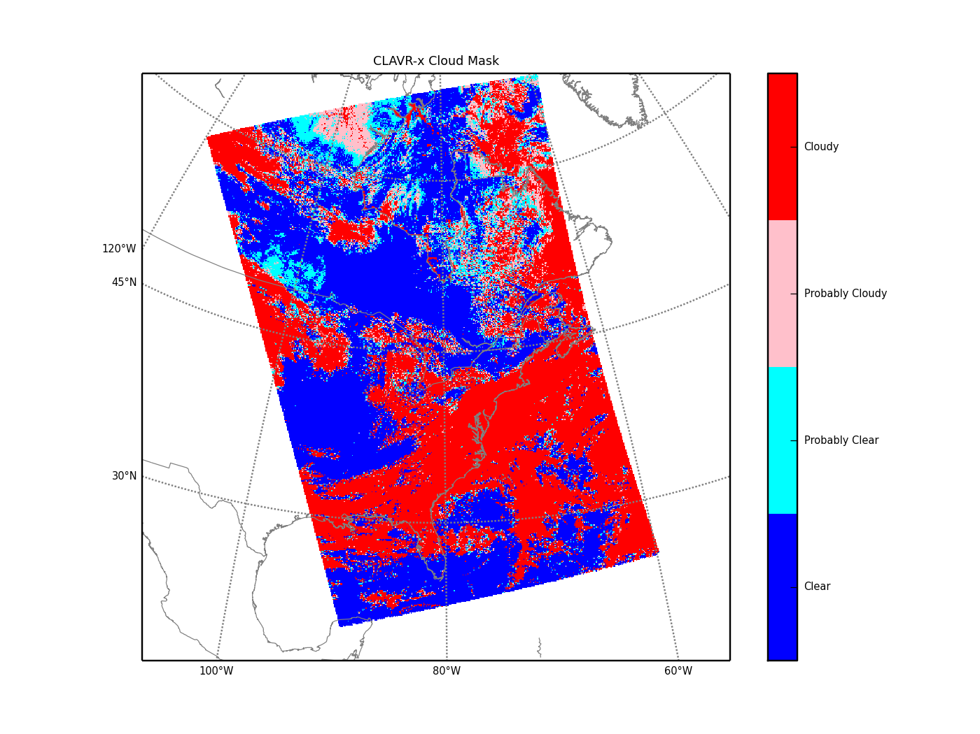
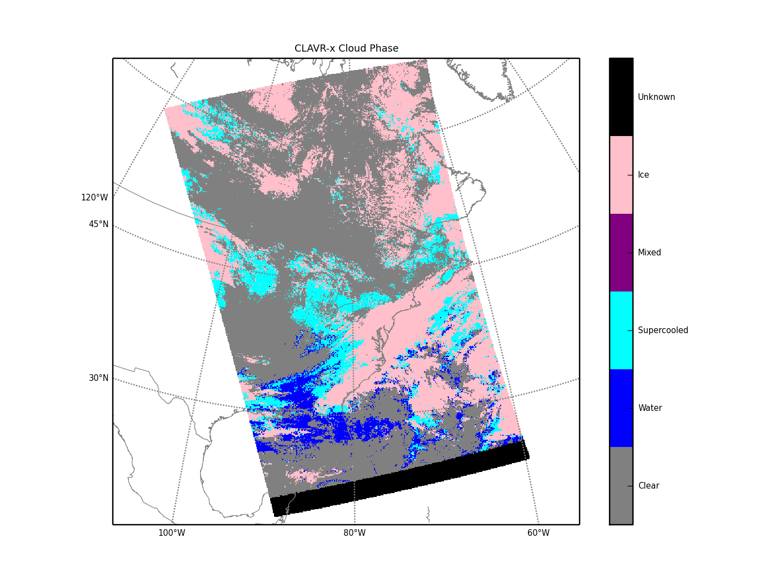
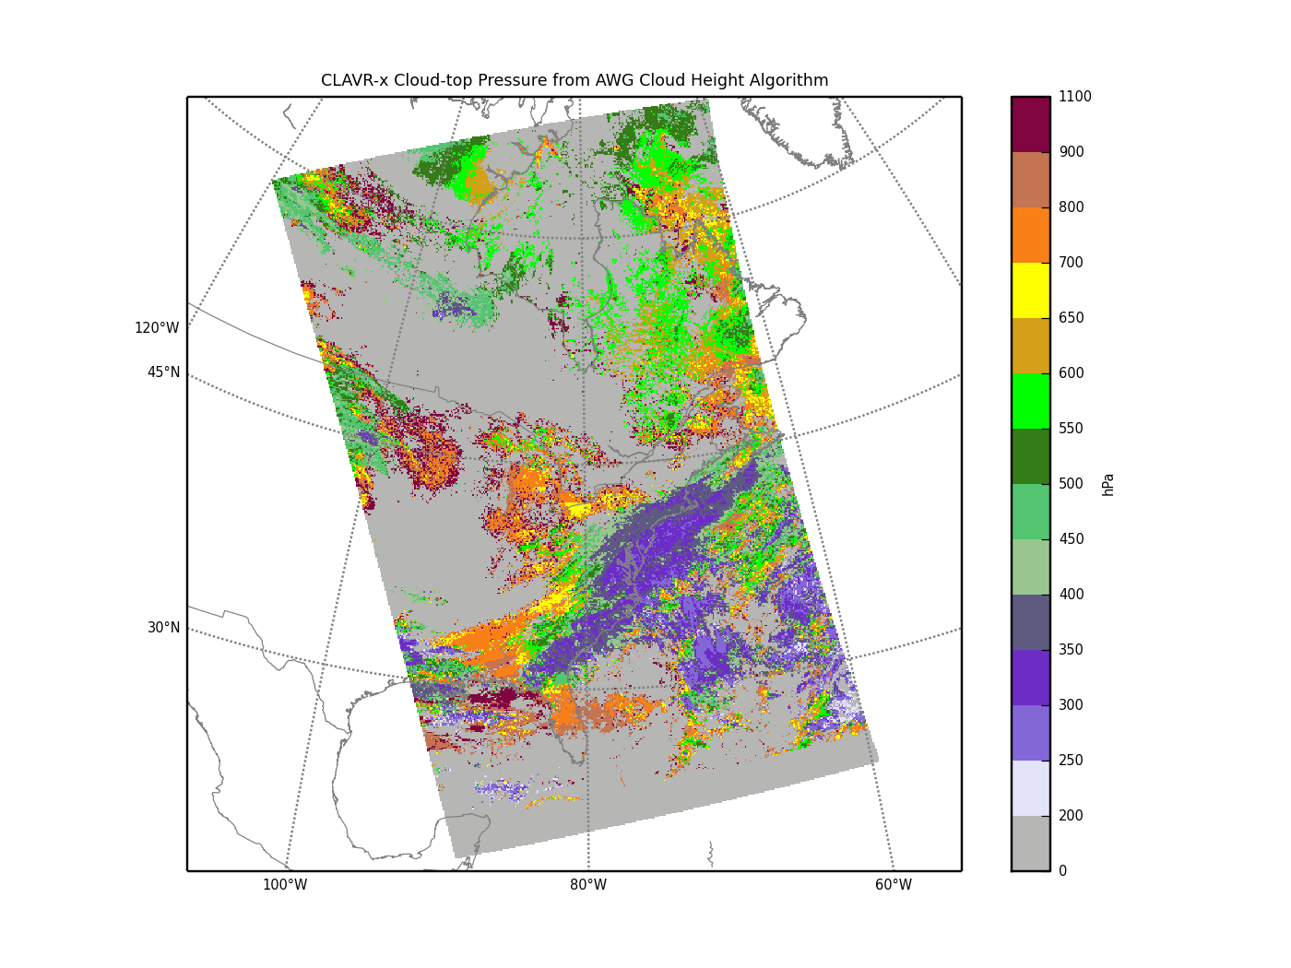
CLAVR-x products from VIIRS DB
2014/03/23
18:13 UTC
VIIRS SVM07
Cloud Mask
Cloud Phase
Cloud Top Pressure

Slide 29
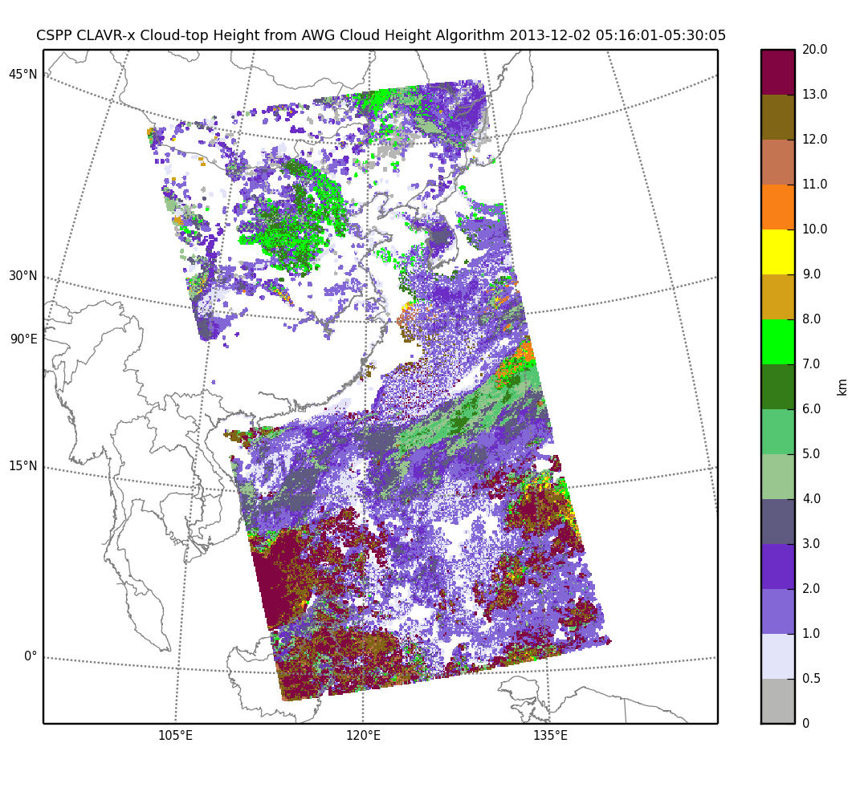
CLAVR-X products from VIIRS DB
CLAVRx used at Taiwan Central Weather Bureau

Slide 30
Hydra2
Multispectral Data Toolkit
A freeware data analysis toolkit for satellite data developed to assist research and development of remote sensing applications as well as education and training of remote sensing scientists
Allows interactive display of Level 1B and Level 2 products from multispectral imagers (VIIRS, MODIS), high spectral resolution sounders (CrIS, IASI, AIRS), and microwave sounders (ATMS, AMSU).
Designed to be easy to learn and use, especially for students.
Supported on Windows, OS X, and Linux.

Slide 31
Hydra2 Screenshots
(SNPP 2012/08/30 04:16Z)
Hydra 2 display of collocated VIIRS and ATMS
Hydra 2 display of CrIS

Slide 32
Training Workshop
2013 Hawaii Polar Orbiter Workshop: Satellite Direct Broadcast for Real-Time Environmental Applications
Location: University of Hawaii - Manoa
Date: 20-23 August 2013
Foster Operational Use of Polar Orbiter Data
Course consisted of University of Hawaii Graduate Students, NWS Operational Forecasters and Joint Typhoon Warning Center employees
Course consists of morning lectures and afternoon hands on laboratory investigations of DB data
Students present results of their own short research study on a topic of their choosing
Workshop Website: http://cimss.ssec.wisc.edu/dbs/Hawaii2013/

Slide 33
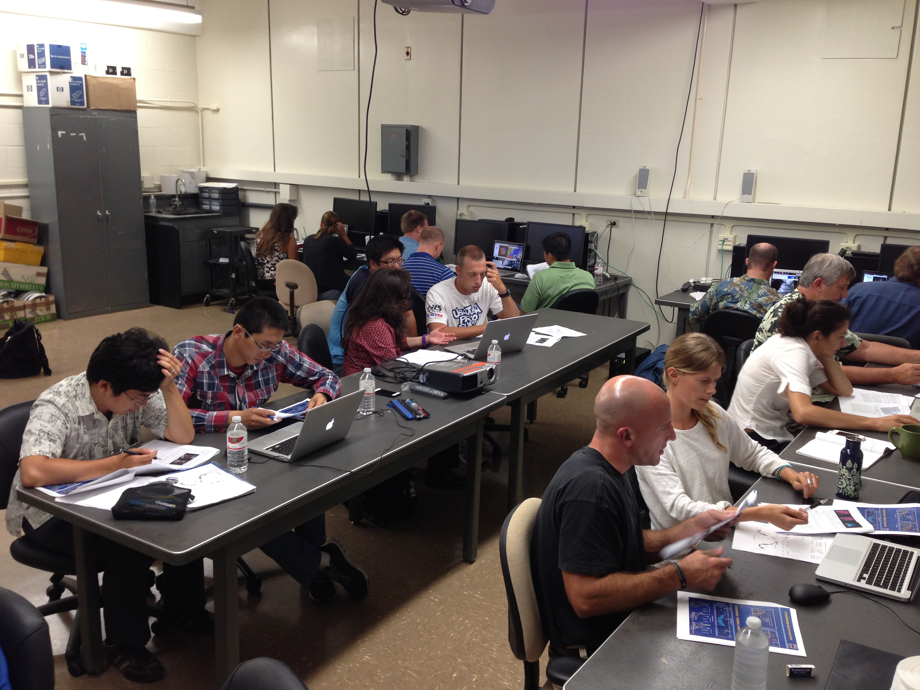
Demonstrations
Students working on a lab during the Hawaii VIIRS/MODIS direct broadcast application workshop.

Slide 34
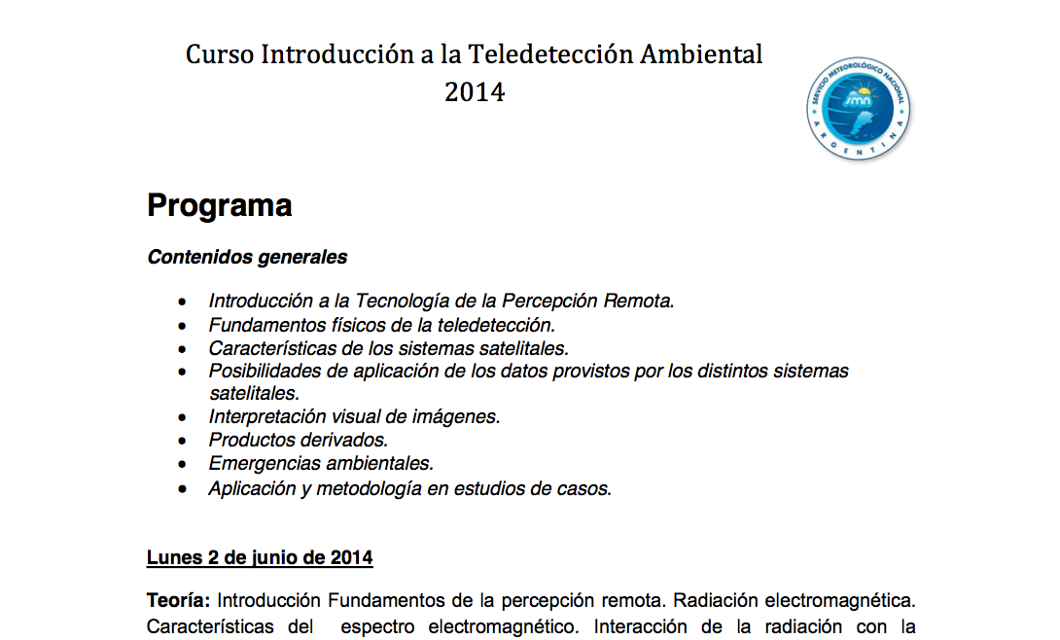
Remote Sensing Course
Using Hydra2
Provided by Diana Rodriguez, Argentina Met Service

Slide 35
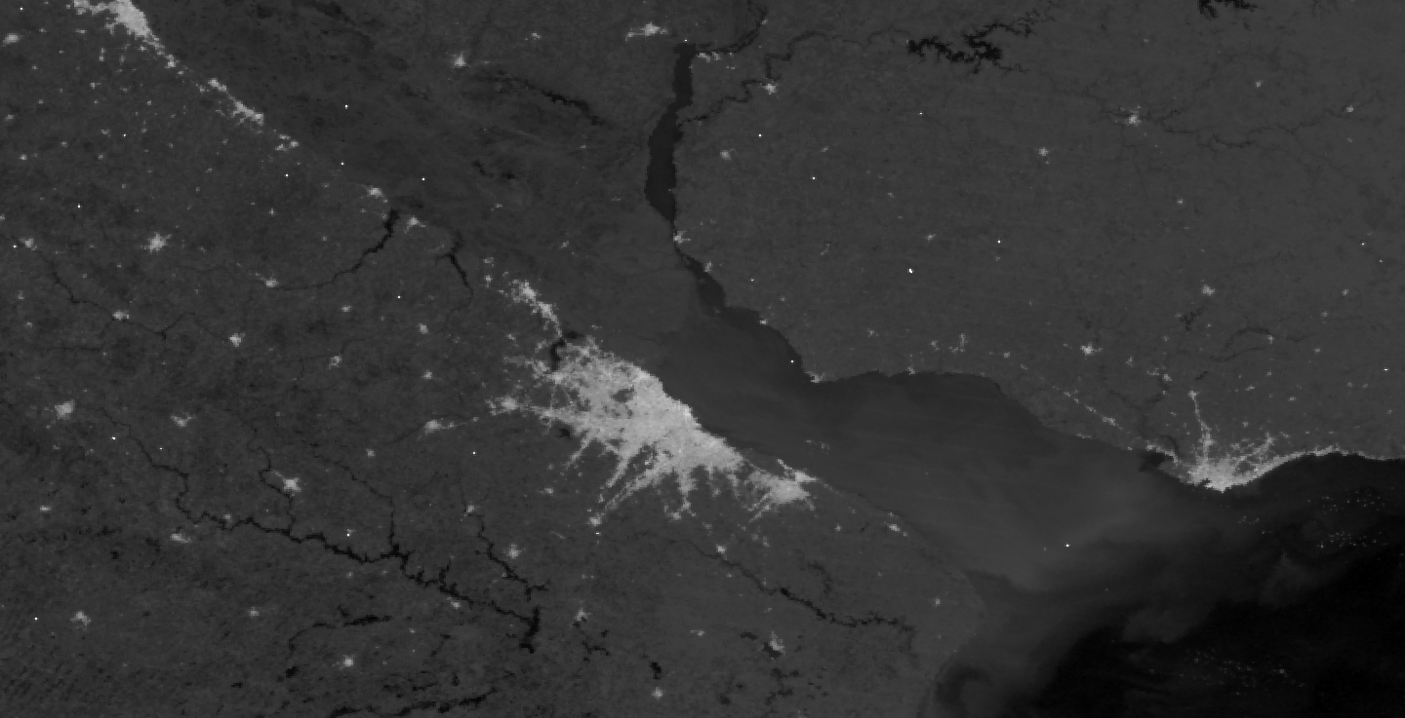
Remote Sensing Course
Using Hydra2
Provided by Diana Rodriguez, Argentina Met SErvirce
Hydra 2 display of VIIRS DNB, Nighttime view of Buenos Aires

Slide 36
VIIRS Imagery EDR
Creates projected VIIRS image data on a Ground Track Mercator grid.
With small reformatting effort, product can be directly ingested into NWS AWIPS2.
Supports I-band resolution (375 meters).
Provides VIIRS Near Constant Contrast (NCC) product for Day/Night Band.
Software currently being executed in GINA AK, UW and soon in Honolulu, in support of realtime NWS use.
Distribution example: ftp://ftp.ssec.wisc.edu/pub/eosdb/npp/viirs/2014_11_17_321_2017/edr/

Slide 37
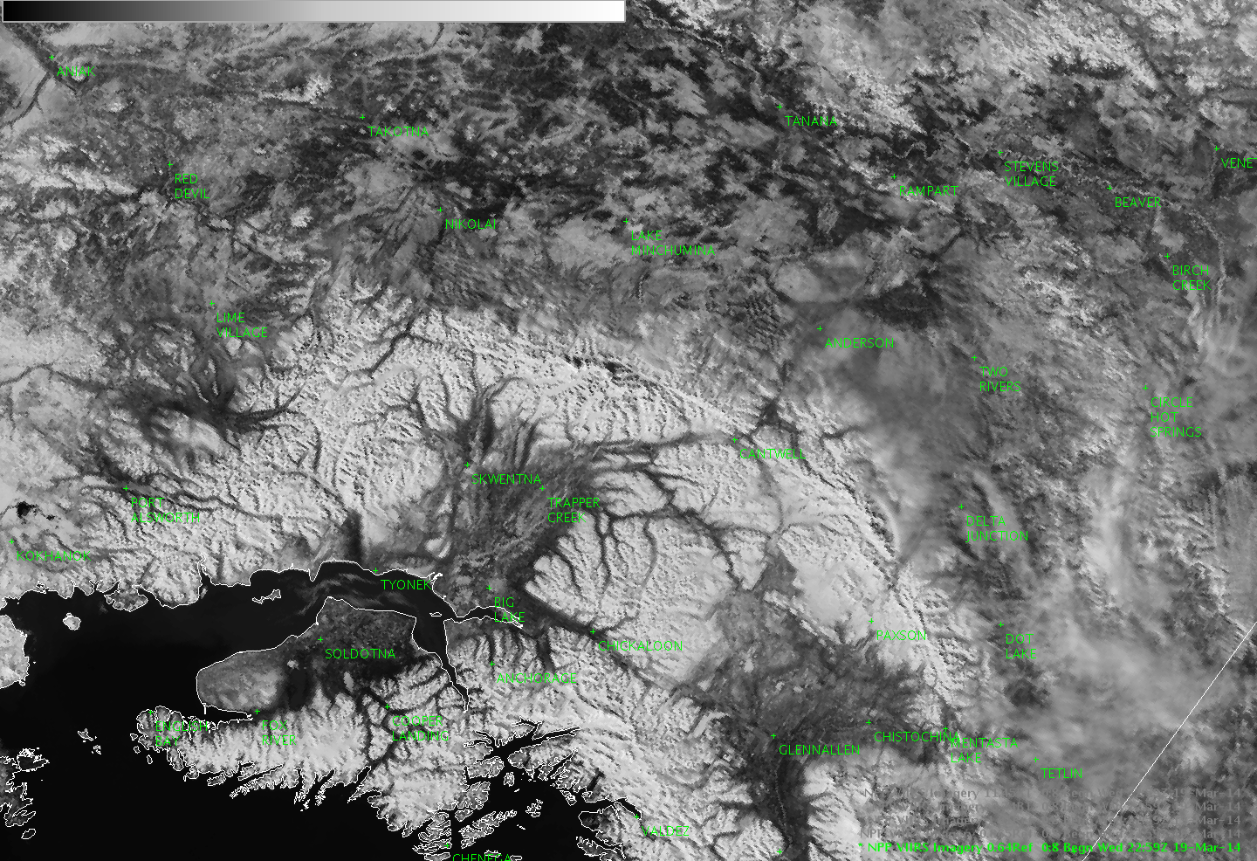


VIIRS Imagery EDR I-Band 1 in AWIPS-II
Processed using CSPP Software including conversion to NetCDF4 19 March 2014

Slide 38
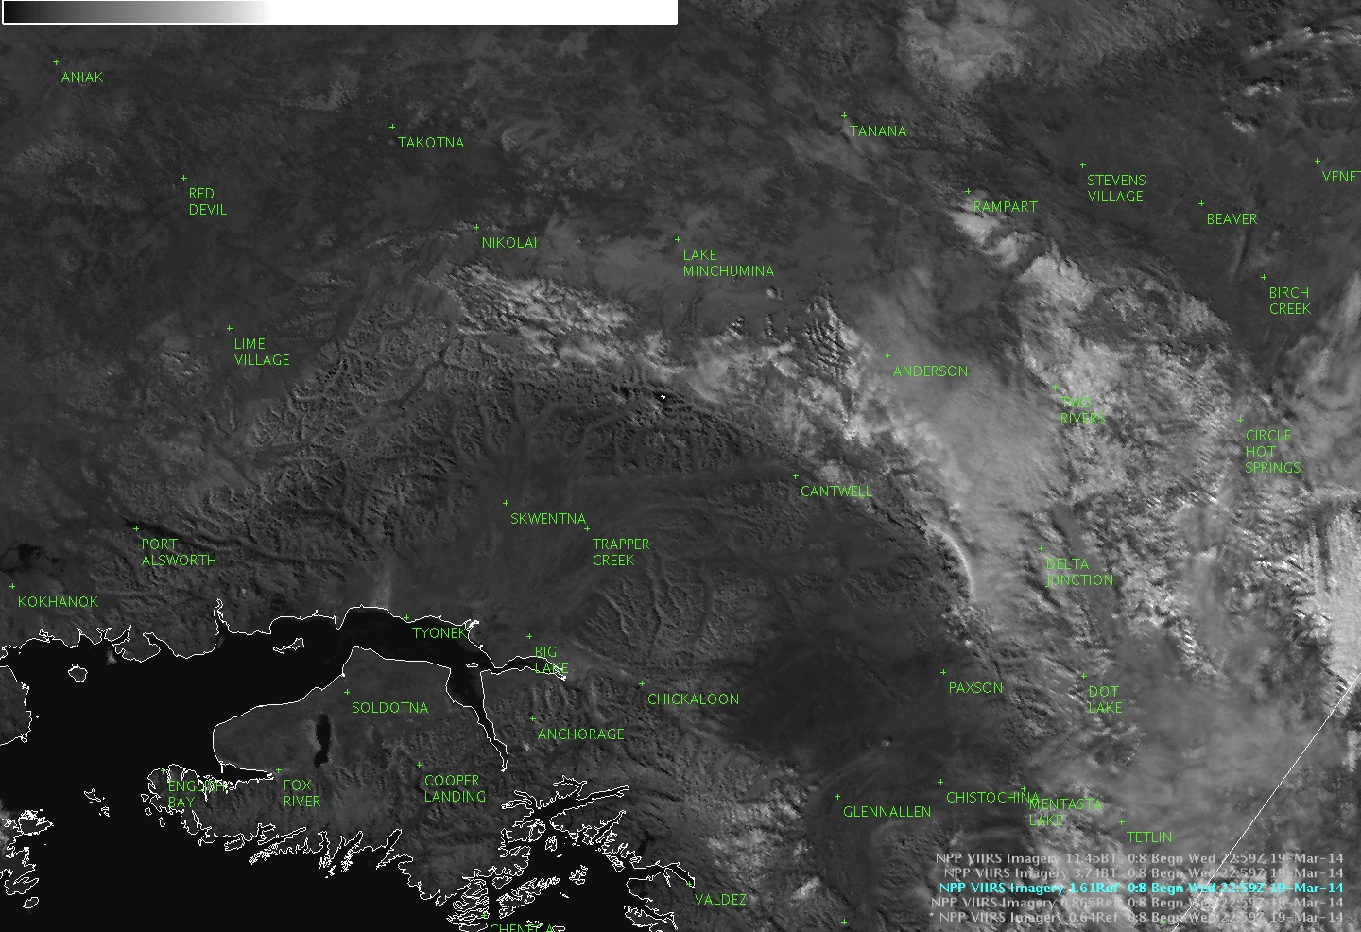
VIIRS Imagery EDR I-Band 3 in AWIPS-II
Processed using CSPP Software including conversion to NetCDF4 19 March 2014

Slide 39
Coming Soon
CSPP SDR software based on Mx8.6 updated science algorithms for all SDRs and EDRs, plus OMPS instrument SDR.
Software to produce CrIS Full Spectral Resolution SDRs.
NUCAPS profiles of temperature, moisture, ozone, and other trace gases; cloud and surface products; and other products from cloud cleared radiances from CrIS/ATMS.
  Development led by Chris Barnet.
  Also supports IASI/AMSU/MHS and AIRS/AMSU.
  Currently in testing on CSPP development systems at SSEC/CIMSS.
ASCPO - Derives cloud cleared sea surface temperatures from VIIRS, MODIS, and AVHRR Level 1B imagery.
  Development led by Alex Ignatov.
  Currently in testing on CSPP development systems at SSEC/CIMSS.
  NWS eager to view VIIRS SST in AWIPS.

Slide 40
Coming Soon:
CSPP GEO
NOAA GOES-R Project is funding the development of a CSPP GEO software package.
Supported satellites/sensors will include GOES-R ABI (GRB), GOES-N Imager (GVAR), and Himawari-8 AHI (HSF).
CSPP GEO will create Level 1B products for all sensors on GOES-R (from GRB downlink).
CSPP GEO will create atmosphere, cloud, and surface products from ABI Level 1B data via the GEOCAT framework.

